Slide 1
Soccer Shoe Store
The purpose of this website is to provide an online shopping experience to soccer teams and players of all ages. This is your one stop shop online store for exclusive soccer shoes from around the world. We carry all sorts of brand name shoes from all around the world.

Slide 2
Home page
Shoe warranty
Location
Shoe brands & Size
Budget

Slide 3
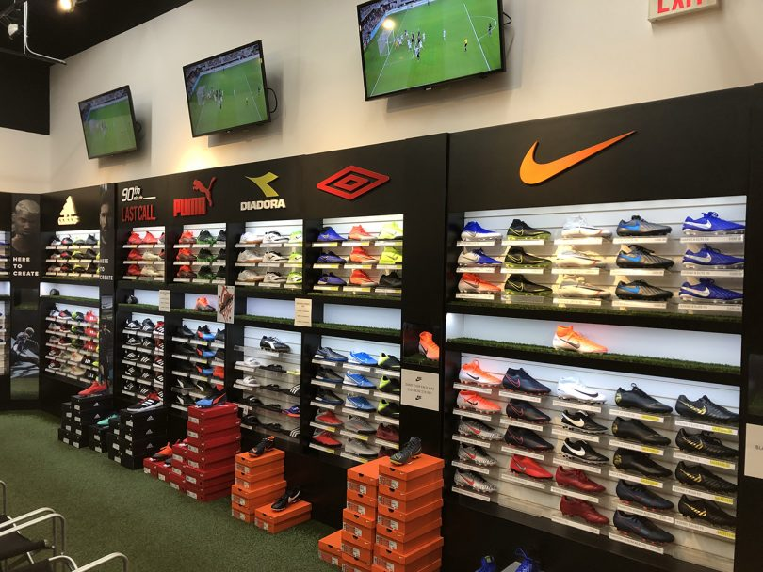
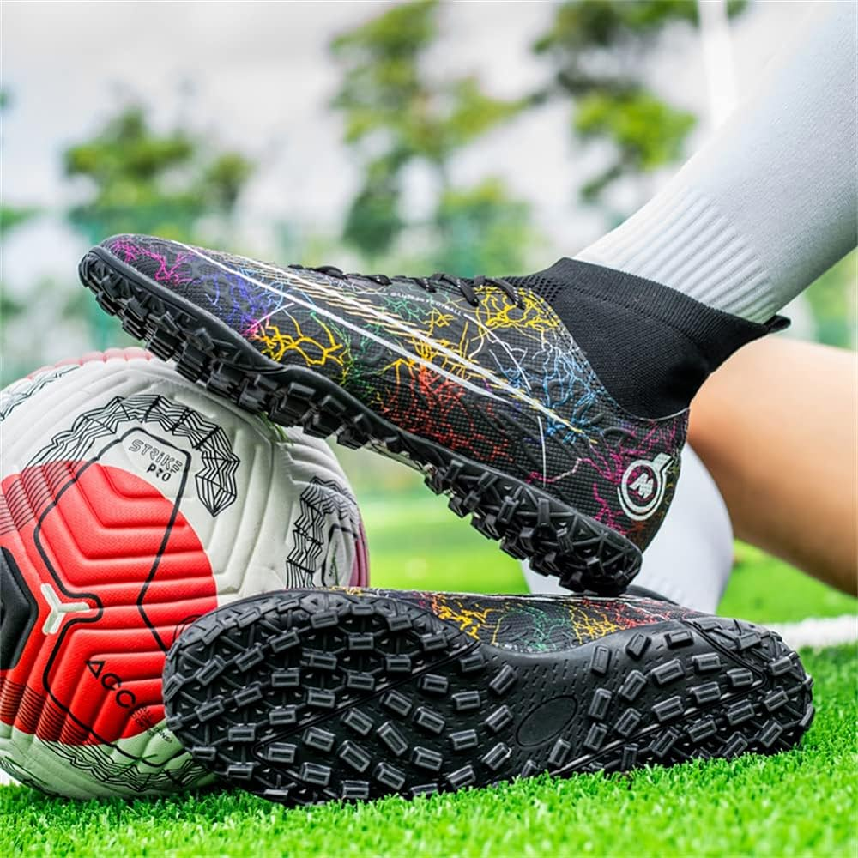
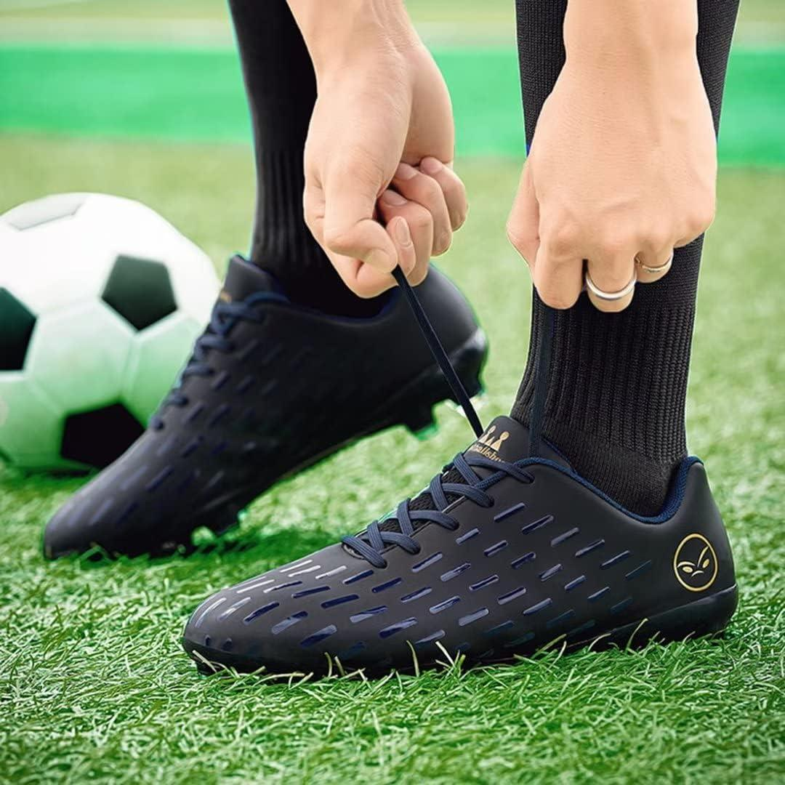

Nav bar
Home
When selecting soccer gear, it is important to get advice from the pros at “international soccer” store. We have the best selection for soccer shoes in the country. Whether you are looking for indoor or outdoor soccer shoes you will find a great selection at our store.
Indoor shoes -are used for hard ground surfaces like dirt and cement floors.
Outdoor shoes – are used for soft surfaces like grass and astroturf. These shoes have different cleat sizes to make sure the taurine is not slippery for the players when they are on the field.

Slide 4
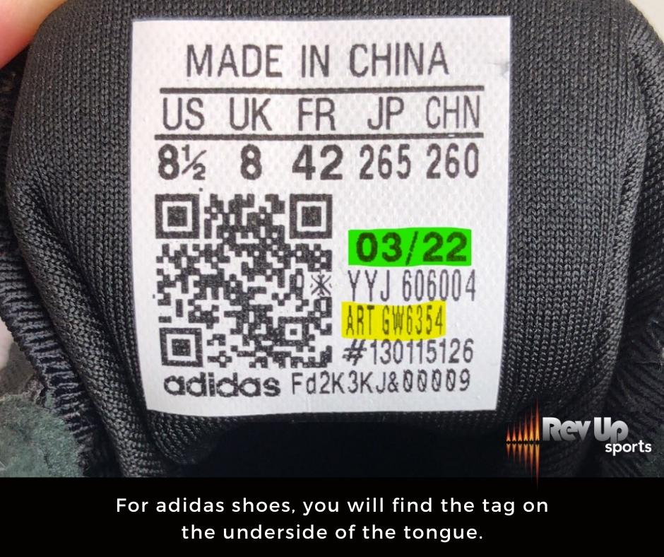
Nav bar
Shoe Warranty
Footwear warranty consist of a 30 day return policy for women, men, and kid’s shoes that are priced at or below $60 us dollars. Footwear warranty for shoes that are $150 to 300 us dollars have a warrant of 6 months plus a possible extended warranty with the footwear company. Warranty does not include damage caused by improper care, misuse, or neglect. Additionally, normal wear and tear are not covered.

Slide 5
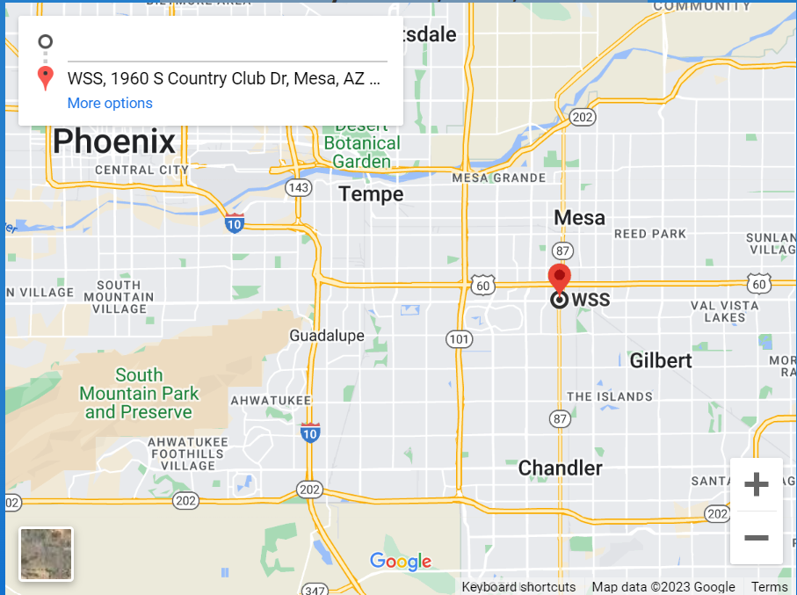
Nav bar
Map & Location
1960 S Country Club Dr, Mesa, AZ 85210

Slide 6
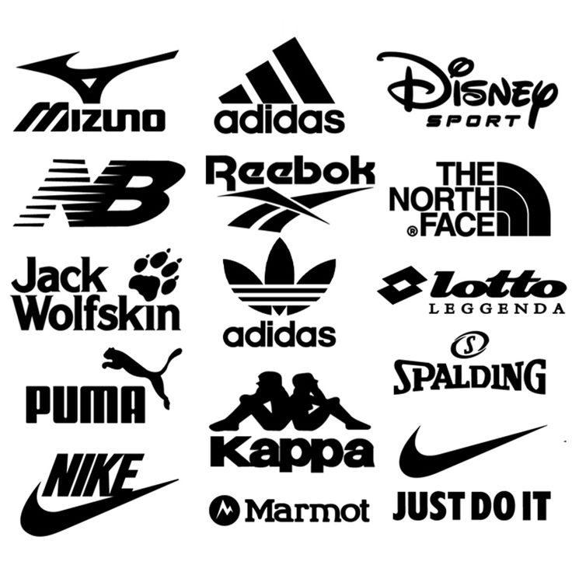
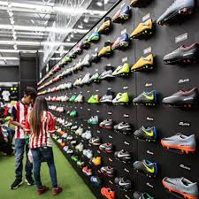
Nav bar
Soccer Brands & Size
Shoes Brands
Nike
Adidas
New Balance
Kelme
Asics
Mizuno
Under armor
Shoes size
Every company has specific measurements for shoe sizes for cleats depend on your region. Some shoe brand has smaller sizes and some have large size of footwear.
Men sizes- They run big and are designed for men
Women sizes- they run smaller and are designed for women feet.

Slide 7
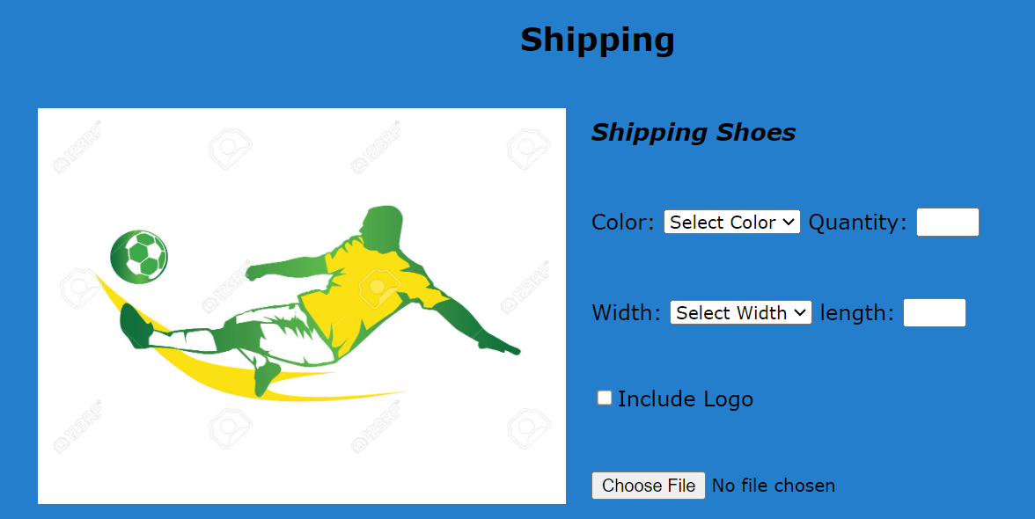
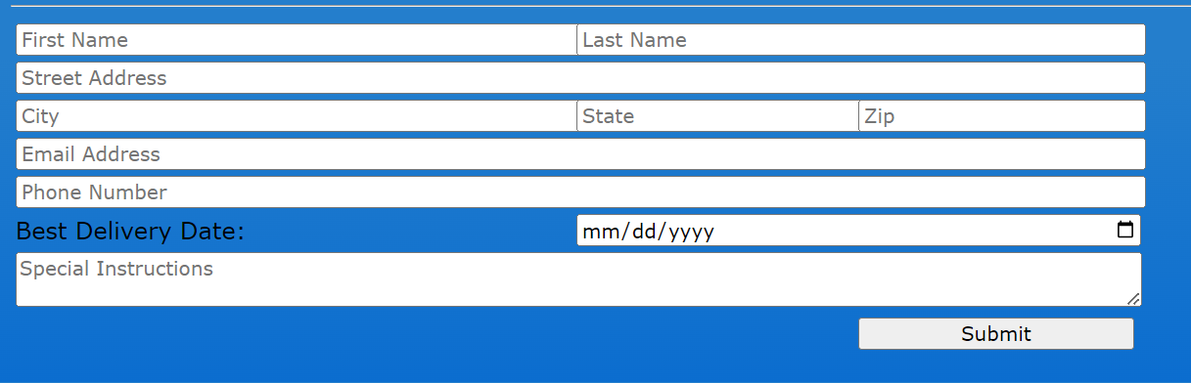
Nav bar
Budget for Soccer Shoes!
When it comes to selecting footwear, it is important to set a budget so you know how much you can spend on footwear. Important things to think should be the size, color, material, cleat size, and comfort level of the shoe.

